Slide 1
Foundations of Data Science & Analytics DSCI 633, Fall 2021
Lecture 25
(material sources cited in the last slide)
Nidhi Rastogi
Assistant Professor, GCCIS, RIT
November 30, 2021

Slide 2
Course Information
GitHub link - https://github.com/aiforsec/RIT-DSCI-633-FDS
For project related questions, reach out to the TA/ Instructor during office hours, via Slack, or email for any questions, suggestions, concerns, or general chat about data science.
Presentation dates
Team 1,2,3 on 12/2/2021
Team 4,5,6,7 on 12/7/2021

Slide 3
Deep Computer Vision using Convolutional Neural Networks (CNNs)
Notes:
Despite how commonly used object detection, or computer vision, is, not many people actually understand its inner-workings, or even give it a second thought.
Everyone should have at least a baseline understanding of how the technology works. Computer vision is already disrupting so many aspects of our lives, from online shopping to medical diagnosis.

Slide 4

Motivation
Example – Detecting objects say, for Self Driving Cars
Notes:
take self-driving cars, for example. Self-driving cars need to be able to recognize objects, like street signs and other vehicles, in order to operate autonomously.

Slide 5
Convolutional Neural Networks
Most computer vision algorithms use something called a convolution neural network, or CNN.
A CNN is a model used in machine learning to extract features, like texture and edges, from spatial data.
A convolution is a process of extracting features from an image by altering the picture.
Notes:
A Convolutional Neural Network is a form of deep learning that used to analyze images and detect patterns using convolutions.
To perform this, CNNs use a series of convolutions on the input image to obtain a prediction.
CNNs can be considered unsupervised — clustering, or supervised learning — classification, depending on what the requirement is. But generally, it’s supervised.

Slide 6
Convolutional Neural Networks
Complex visual tasks
Power image search services
self-driving cars
automatic video classification systems
Not restricted to visual perception
voice recognition
natural language processing (NLP)
We will focus on visual applications – image classification
Notes:
Have managed to achieve superhuman performance on some complex visual tasks. They power image search services, self-driving cars, automatic video classification systems, and more. Moreover, CNNs are not restricted to visual perception: they are also successful
at many other tasks, such as voice recognition or natural language processing (NLP); however, we will focus on visual applications for now.
The most prevalent use of CNNs is for image classification. One prime example is classifying handwritten digits, classifying whether a picture is a dog or a cat, among many others.

Slide 7
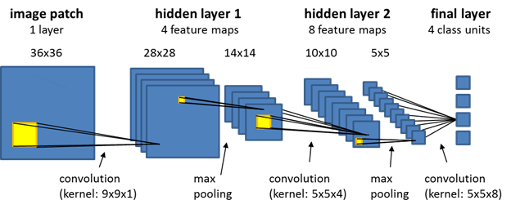
Basic Layout of a CNN
CNNs learn from inputs
adjusting parameters (weights and biases) to make an accurate prediction.
Can extract features from images
Notes:
Like basic feedforward neural networks, CNNs learn from inputs, adjusting their parameters (weights and biases) to make an accurate prediction. However, what makes CNNs special is their ability to extract features from images.
CNNs have an input layer, some hidden layers, and an output layer that outputs the transformed input—the hidden layers inside a CNN use filters. Filters are detectors for patterns. In the beginning, the CNN only starts to detect edges and shapes. As the algorithm progresses, it starts to detect tangible objects, such as an ear.

Slide 8
Example of using a CNN
Example : Object to be detected is a car
Normal feedforward neural network – flatten image into feature vector
CNNs treat images like matrices as they exist
extract spatial features from them - texture, edges depth
HOW?
by using convolutional layers and pooling
Notes:
Take an image of a car, for example. In a normal feedforward neural network, the image would be flattened into a feature vector. However, CNNs are able to treat images like matrices as they exist and extract spatial features from them, like texture, edges and depth. They do this by using convolutional layers and pooling.

Slide 9
Working of Convolutional Layers
Consider convolutional layer as set of feature maps
Each layer applies a series of image filters to an input image represented as a matrix
Resulting filter image (output of that CL) , or feature maps, have different appearances, as they extracted different features.
These image filters are called convolutional kernels.
Notes:
You can think of convolutional layers as a set of feature maps — the convolutional layer applies a series of image filters to an input image represented as a matrix. The resulting filter images, or feature maps, have different appearances, as they extracted different features.
These image filters are called convolutional kernels.

Slide 10
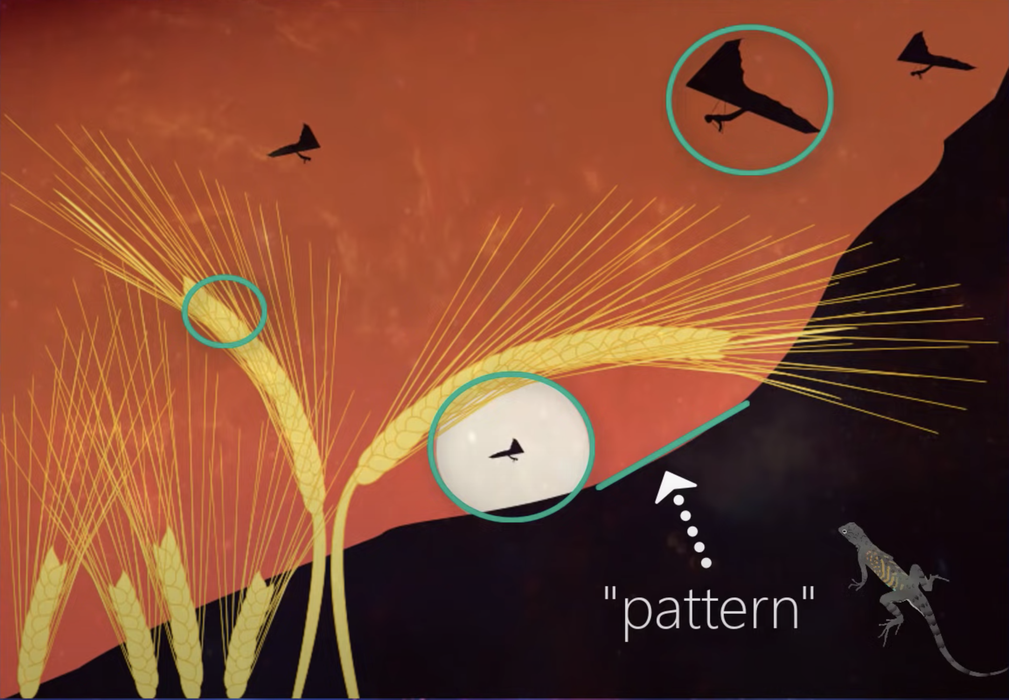
Role of a Convolutional Layer
Role of CL: detect patterns
Use filters (one or more) for each layer
Patterns are edges, shapes
geometric shapes easier and are detected in previous layers.
Notes:
So the role of a CL is to detect patters, what is a patters, look at this image… walk through the image. So think of all that may be going on in any single image. Multiple edges, shapes, textures, objects. For this edge detector, we will have. Deeper the network goes, the more sophisticated these filters become, Specific objects luke eyes, ears, hair, fur features, scales on fish
For each CL, we specify a number of filters each layer should have. So a CL can have one or more than one filters to detect a pattern.
Filters are what detect patterns at the most granular level.
Dependent on convolutions to extract features and produce a sufficient output. The first type of convolution is a kernel. A kernel is nothing but a filter that is used to extract the features from the images.

Slide 11
Role of a Convolutional Layer
Dependent on convolutions to extract features and produce a sufficient output.
A type of convolution - kernel.
Kernel - filter used to extract features from images.
Notes:
Dependent on convolutions to extract features and produce a sufficient output. The first type of convolution is a kernel. A kernel is nothing but a filter that is used to extract the features from the images.

Slide 12
Analogy
Reading a Book
read from left to right
Absorb information a word at a time
Kernels
extract features from input image from moving left to right
extract features by a set of pixels at a time
Notes:
When we read a book, we extract meaning from the text by reading from left to right. Similarly, a kernel extracts features from the input image from moving left to the right.
Likewise, we tend to absorb information per word, not by reading each letter. Similarly, kernels extract features by a set of pixels at a time.
The most common form of kernel used is a 3 x 3, shown in this picture
each pixel in an image comes with a number value in the range of 0 to 255. For colored images, it’s determined in three channels: red, blue, and green. The higher the number value, the more intensity the pixel produces.
As mentioned before, kernels also have a value associated with each of its blocks.

Slide 13
Using a Kernel
Blue 3x3 matrix represents input image
shaded square passing over it is the convolution kernel
The convolution kernel is a matrix of weights (the subscripts in the shaded square) that passes over a larger matrix.
Each weight is multiplied by the larger number it is shaded over. Then, all of the numbers in the shaded region (9, in this case), are summed, resulting in the green matrix on the right. This green matrix is called a feature map.
0 | 1 | 2
2 | 2 | 0
0 | 1 | 2
filters
Notes:
see a convolution kernel in action. The blue matrix represents the input image, as the shaded square passing over it is the convolution kernel. The convolution kernel is a matrix of weights (the subscripts in the shaded square) that passes over a larger matrix.
Each weight is multiplied by the larger number it is shaded over. Then, all of the numbers in the shaded region (9, in this case), are summed, resulting in the green matrix on the right. This green matrix is called a feature map.

Slide 14
Strides
Striding -> Number of pixels by which kernel moves in either direction.
Stride is [1,1] Stride is [2,2]
Larger the stride, the smaller the feature map
Notes:
Images contain thousands of pixels is bound to contain all sorts of data. Attempting to process an abundant amount of pixels is computationally expensive and difficult to debug and organize. This imposes the ideal time to use the stride parameter.
Striding defines the number of pixels by which the kernel should move in either direction.
In this illustration, the stride is [1,1]. This tells the kernel to move 1 pixel right while moving along the row and move 1 pixel down while moving around the column. The output is a 3x3 image.
In this illustration, the stride is [2,2]. This tells the kernel to move 2 pixels right while moving along the row and move 2 pixels down while moving around the column. The output is a 2x2 image.
As depicted, the larger the stride, the smaller the feature map (or convoluted image) is. On that note, strides are significant to CNNs because they are used to shrink the image size drastically.

Slide 15
Pooling
If we had many convolution kernels (meaning many feature maps) -> data would have a lot of dimensions.
Leads to overfitting.
Use pooling to reduce the dimensionality.

Slide 16
Pooling
Why Pooling: used to reduce the size of a feature map.
Moves n x n filter (i.e., 3x3 filter) over the features and takes one value determined over the input pixels.
Several ways of pooling
maximum of input pixels (Max Pooling)
sum of all values (Sum Pooling)
average of all values (Mean Pooling).
Most common – max pooling
Notes:
If deducing to 1/4 of the input image is enough to determine what the whole image displays, there is no point in processing all 4/4s of the image. This is where pooling plays a role.
Pooling is used to reduce the size of a feature map.
Pooling moves a n x n filter (i.e., 3x3 filter) over the features and takes one value determined over the input pixels. That one value can be found in several ways: it may be the maximum of the input pixels (Max Pooling), the sum of all the values (Sum Pooling), or the average of all values (Mean Pooling). The most commonly used type of pooling is Max Pooling.

Slide 17
Max Pooling
blue matrix is a feature map
purple matrix slides over blue feature map
kernel doesn’t have weights — it selects the largest numbers in the feature map, seen in the matrix at the right
Notes:
Let’s pretend that the blue matrix on the left is a feature map in the convolution layer. Similar to a convolution kernel, the purple matrix slides over another matrix, in this case the blue feature map. However, the kernel doesn’t have weights — it selects the largest numbers in the feature map, seen in the matrix at the right

Slide 18
Max Pooling contd..
Size of feature maps reduced after going through the max pooling layer.
output is passed into another convolution layer and max pooling layer, and another and so on.
Number of layers depend on complexity and abundance of data.
Notes:
The size of the feature maps are now reduced after going through the max pooling layer. Then, the output is usually passed into another convolution layer and max pooling layer, and sometimes even another. The amount of layers you have will depend on the complexity and abundance of your data.

Slide 19
Example of inputs mapped to outputs
Notes:
The size of the feature maps are now reduced after going through the max pooling layer. Then, the output is usually passed into another convolution layer and max pooling layer, and sometimes even another. The amount of layers you have will depend on the complexity and abundance of your data.

Slide 20
Max Pooling contd..
After the last max pooling layer -> matrix is flattened
Used as input into a fully connected layer
Imperative that you know dimensions of your data after last max pooling layer
Notes:
After the last max pooling layer, the matrix is actually flattened and used as input into a fully connected layer. It’s therefore imperative that you know the dimensions of your data after the last max pooling layer so that you can define your feedforward layer accordingly. We will learn how to do this below.

Slide 21
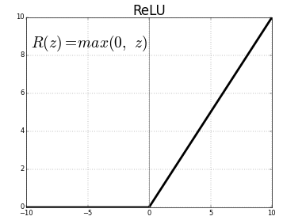
Activation Function
An activation function is used after the convolutional layer, usually ReLU.
ReLU is the most commonly used activation function in CNNs.
Notes:
ReLU is the most commonly used activation function in CNNs. If you’re a machine learning developer, ReLU is usually your best friend.

Slide 22
Padding
When we create a convolutional layer, the kernel cannot always perfectly overlay the edges or corners of images. Padding allows us to control the spatial size of the output volumes.

Slide 23
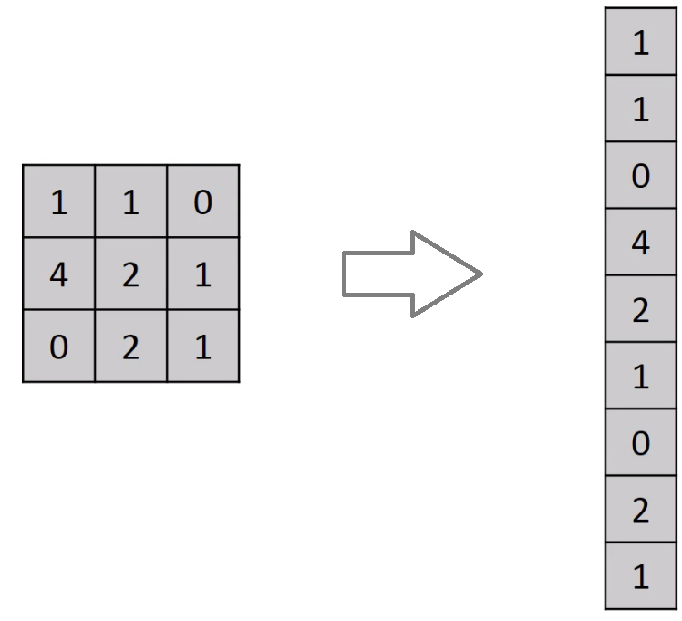
Prediction
After many kernels and pooling -> Prediction
Algorithm can now detect features -> eyes, ears, scales, …
Flattening comes into picture now.
Notes:
Once the algorithm has used many different kernels and pooling techniques, it’s time for the prediction. At this point, the algorithm can now detect eyes, ears, whiskers, and a face. Now, all it has to do is predict that the image is of a cat. That’s where flattening comes into the picture.
Flattening is the function that converts the pooled feature map to a single column that is passed to the fully connected layer. flattening is a simple concept to grasp, automatically clicking after re-reading a few times. Flattening is important to convert the extracted features from the convolutions into an actual predicted output that the algorithm spits out.

Slide 24
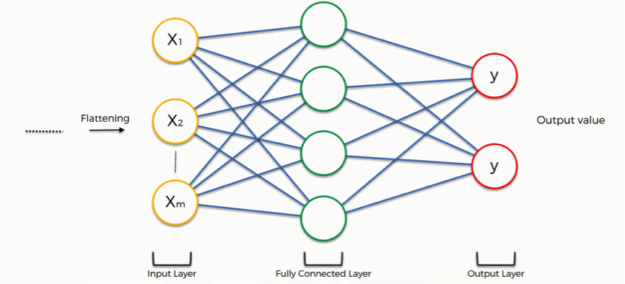
Prediction
After flattening - > feature map passed through NN.
Notes:
After flattening, the flattened feature map is passed through a neural network. This step comprises the input layer, the fully connected layer, and the output layer in an Artificial Neural Network (ANN). The output layer is where we get the predicted classes. The information is passed through the network, and the error of prediction is calculated. The error is then backpropagated through the system to improve the prediction.

Slide 25

Summary
Notes:
After flattening, the flattened feature map is passed through a neural network. This step comprises the input layer, the fully connected layer, and the output layer in an Artificial Neural Network (ANN). The output layer is where we get the predicted classes. The information is passed through the network, and the error of prediction is calculated. The error is then backpropagated through the system to improve the prediction.

Slide 26
Coding

